Slide 1
Data Engineering
Jordy Vercammen

Slide 2
Introduction
Former IMS Student
Colleague of Steve
…

Slide 3
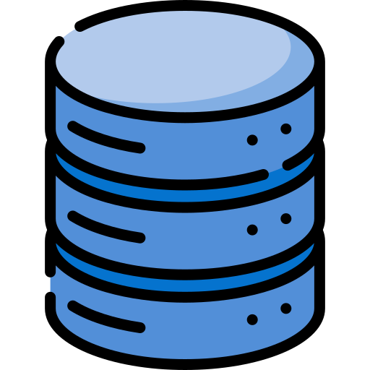
What is a Database
Definition: A database is a storage location for related data that captures a specific situation (e.g., point-of-sale transactions).
Examples:
  POS Database: Stores retail transaction data.
  RDBMS: Example includes MS Access.
  NoSQL: Example includes MongoDB.
Variety: Can be structured (relational/RDBMS) or unstructured (NoSQL).
Processing: New data is processed, organized, managed, updated, and stored in tables (for RDBMS).
Purpose: Primarily handles raw transactional data (OLTP – Online Transactional Processing).

Slide 4
What is a Database
Main Characteristics of Databases
  Structured according to company operations and applications
  Rigid rules set around data storage/organization (RDBMS-specific)
  Flexible data storage (NoSQL-specific)
  Single-purpose in its nature: handles one process (e.g., POS)
  Utilized for online transaction processing (OLTP)
  Data recording capabilities, capturing transactions as they occur and housing those transactions

Slide 5
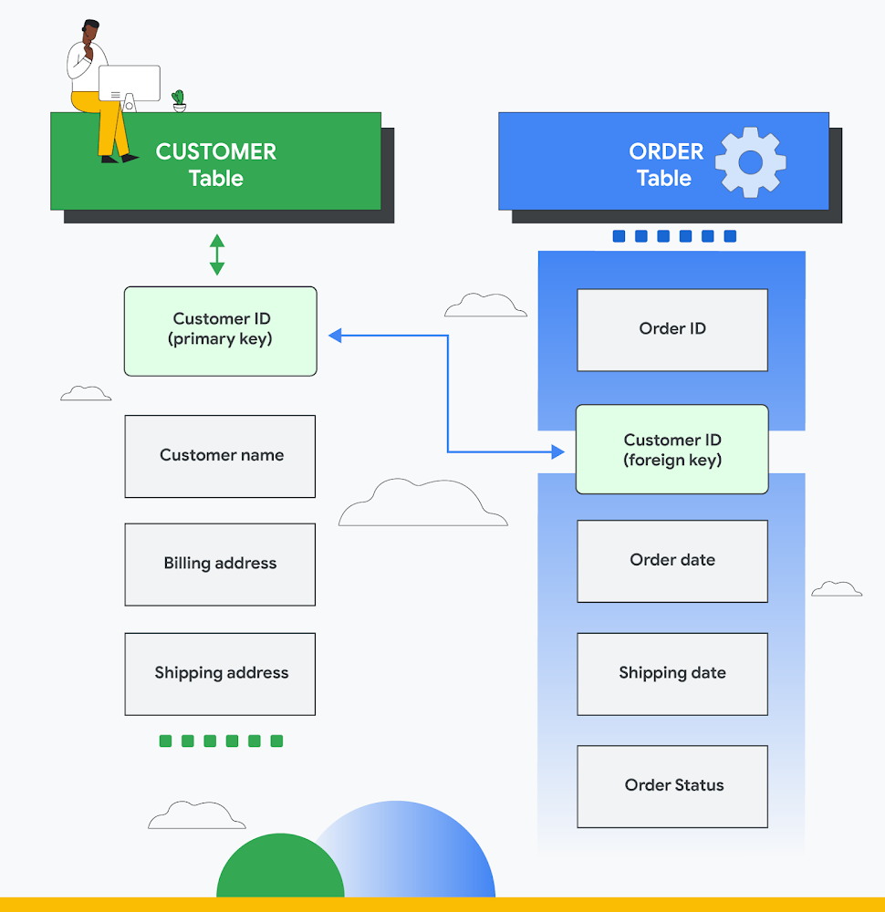
What is a RDBMS

Slide 6
What is a RDBMS
Relational Database Management System
Key Concept: Tables are connected via a common attribute instead of hierarchical structures.
Analogy: Think of each table as a spreadsheet for organizing and relating data.
Structure:
Columns (Attributes): Define the data type (e.g., integer, text).
Rows (Records/Tuples): Contain the actual data values.
Primary Key: A unique identifier for each row in a table.
Foreign Key: A reference to another table’s primary key, establishing relationships across tables.

Slide 7
What is a RDBMS
The Customer table contains data about the customer:
Customer ID (primary key)
Customer name
Billing address
Shipping address
The Order table contains transactional information about an order:
Order ID (primary key)
Customer ID (foreign key)
Order date
Shipping date
Order status

Slide 8
What is a RDBMS
  Order Identification: The primary key (Order ID) uniquely identifies each order.
  Connecting Customers and Orders: A foreign key references the Customer ID in the Order table, linking orders to specific customers.
  Related Tables: Shared Customer IDs across the Customer and Order tables allow for powerful queries and report generation (e.g., customers who purchased on a specific date, delayed deliveries in the last month).
  Complex Relationships: Relational databases can reference data across multiple tables, provided the data adheres to the predefined relational schema.
  Declarative Queries: By organizing data in predefined relationships, users specify what data they need rather than how to compute it—this is the core principle of relational systems.

Slide 9
What is a RDBMS
Some of the most well-known RDBMS:
  MySQL
  PostgreSQL
  MariaDB
  Microsoft SQL Server
  Oracle Database

Slide 10
What is a DWH
  Purpose: A specialized data management system tailored for business intelligence and analytics.
  Usage: Optimized for queries and analysis, containing large volumes of historical data.
  Data Sources: Aggregates information from diverse systems (e.g., application logs, transactional databases).
  Value: Centralizes data for deeper insights, supporting better decision-making and creating a critical historical record.
  “Single Source of Truth”: Consolidates consistent and reliable data for all analytical and reporting needs.

Slide 11
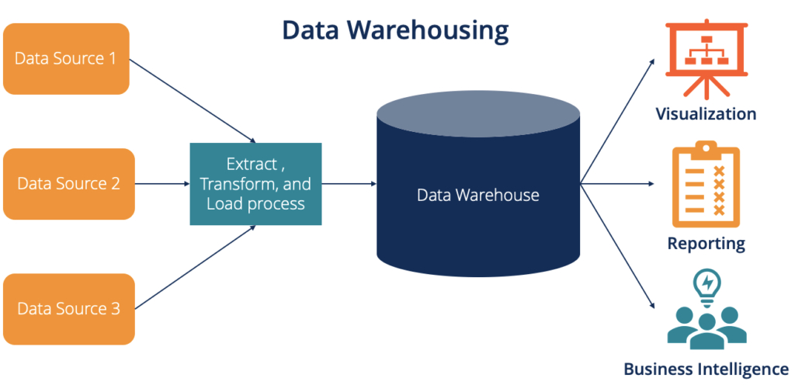
What is a DWH

Slide 12
BENEFITS of a DWH
Integrates data from different sources into 1 data model
Source systems are not queried
  Long-running queries versus transactional systems
Keeps track of history
Central overview of information in the organization
better data quality
  Single version of the truth
  Flagging or repairing the data
1 data model for all information within the organization
Restructures the data
  so that it becomes meaningful for the employees
  Good query performance, even for complex analytical queries, with no impact on the source systems

Slide 13
RDBMS vs DWH
  Analogy: An RDBMS is like a local store (optimized for day-to-day transactions), while a data warehouse is like a storage warehouse (designed for large-scale data analysis).
  RDBMS Focus: Fast transactions, data integrity, and complex queries for operational systems (e.g., online shopping, banking).
  Data Warehouse Focus: Long-term storage, historical analysis, and complex analytical queries for business intelligence and reporting.
  Key Distinction: RDBMS excels at handling real-time transactional data; data warehouses excel at consolidating and analyzing large volumes of data over time.

Slide 14
DATA MART vs DWH
Attribuut
Datawarehouse
Data
Attribuut | Datawarehouse | Data mart
Scope of the data | Entire organisation | Department level
Number of topics within domain | Multiple | Single
Difficulty to build | Complex | Easy
Time to build | Long | Less long
Storage requirements | Large, larger, largest | Contained

Slide 15
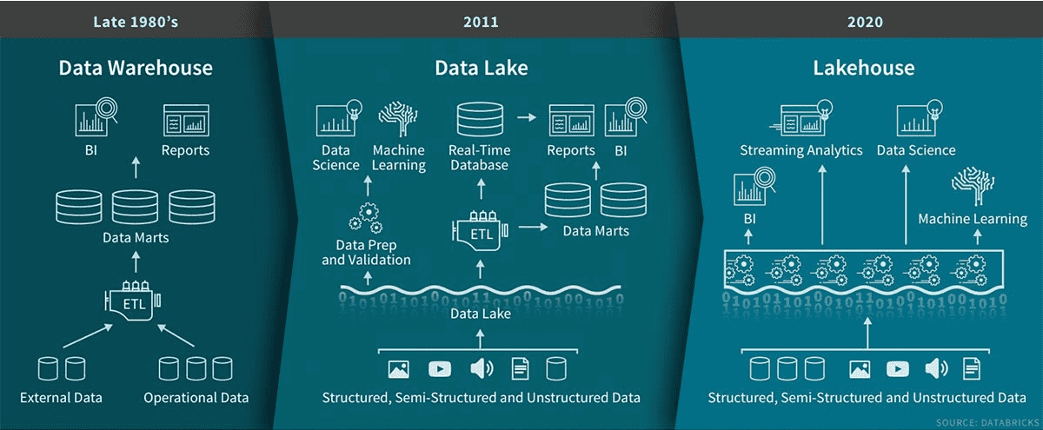
DATALAKE & LAKEHOUSE
Attribuut
Datawarehouse
Data
Notes:
A data lake stores massive volumes of raw, unstructured data using schema-on-read for flexibility and low-cost storage. A data lakehouse combines this with a data warehouse's structured, reliable, ACID-compliant storage (schema-on-write), enabling high-performance SQL analytics, BI, and machine learning directly on the data lake.

Slide 16
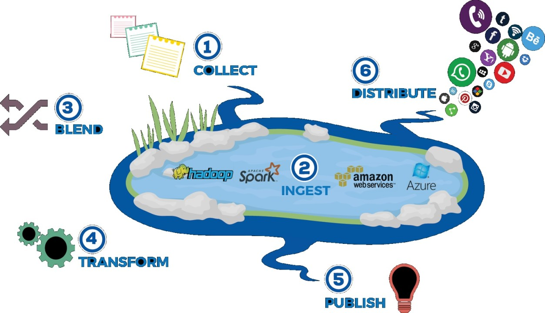
DATALAKE & LAKEHOUSE
James Dixon CTO Pentaho
  “Data marts have several inherent problems, such as information siloing”
Attribuut
Datawarehouse
Data

Slide 17
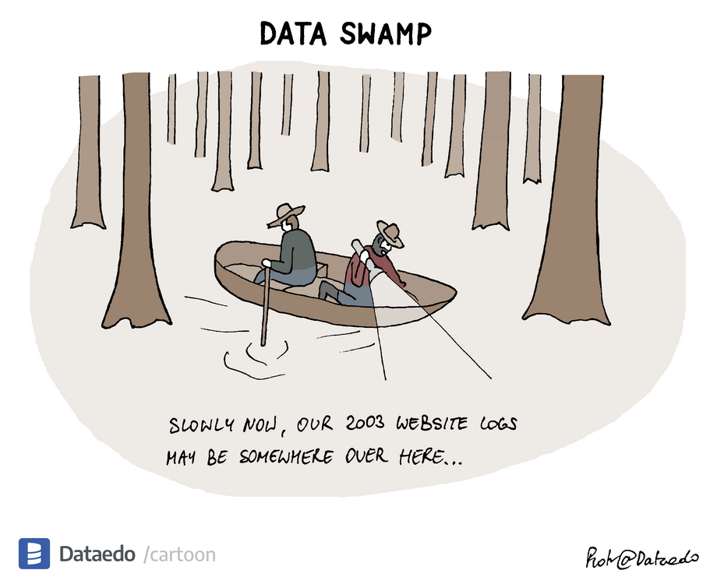
DATALAKE & LAKEHOUSE

Slide 18
How do we keep this organized?

Slide 19
DATALAKE & LAKEHOUSE
  Problem Statement: How best to organize data within data lakes and design ELT (Extract, Load, Transform) processes effectively.
  Traditional Data Warehouse Layers:
  Staging Area: Temporary landing zone for raw data.
  Data Warehouse: Central repository, structured for analytical queries.
  Data Mart: Subset of the warehouse data, tailored to specific business needs.
Attribuut
Datawarehouse
Data

Slide 20
DATALAKE & LAKEHOUSE
  Data Lakehouse Approach:
  Hybrid Model: Combines the flexibility of a data lake (handling diverse raw data formats) with the transactional guarantees (ACID) and data quality controls of a warehouse.
  Advantages:
    Flexible Storage: Capable of storing unstructured, semi-structured, and structured data.
    Management & Tools: Incorporates robust management features (e.g., metadata handling, governance) traditionally found in data warehouses.
  Outcome: Simplifies architecture by enabling both big data processing and traditional analytics in one system.
  According to Oracle: Data lakehouses integrate “the flexible storage of unstructured data from a data lake and the management features and tools from data warehouses.”
Attribuut
Datawarehouse
Data

Slide 21
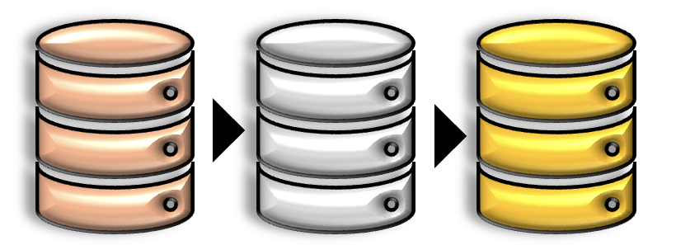
MEDALLION ARCHITECTURE
Definition: Layered approach to process & refine data
Core idea: Incrementally improve data quality and structure
3 Key Layers: Bronze (Raw), Silver (Cleansed), Gold (Enriched/Ready)
Popular in: Databricks, Azure Synapse, BigQuery, Snowflake & modern data lake solutions
Attribuut
Datawarehouse
Data

Slide 22




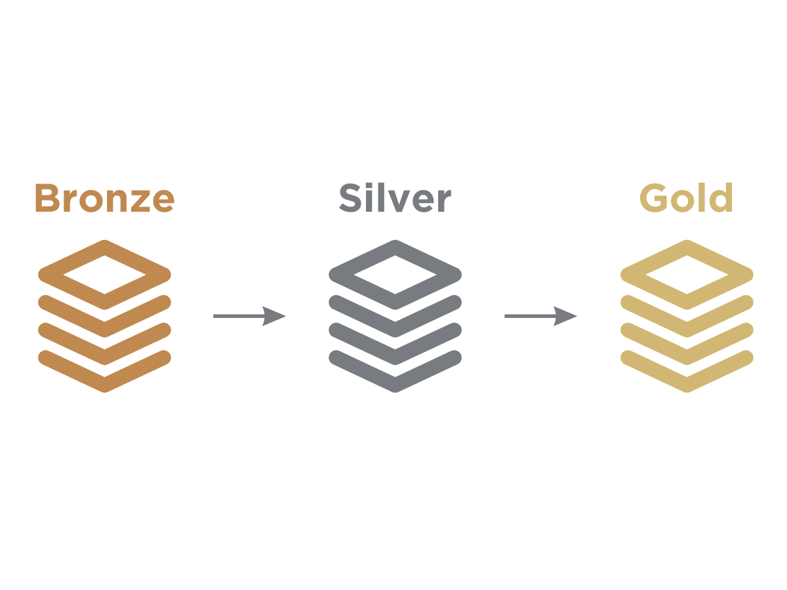
MEDALLION ARCHITECTURE
Attribuut
Datawarehouse
Data

Slide 23

MEDALLION ARCHITECTURE
Purpose: Store raw data “as-is”
Characteristics:
    Minimal or zero transformation
    Original file formats (CSV, JSON, Parquet)
Advantages:
    Complete data fidelity
    Easily reprocess if needed
Attribuut
Datawarehouse
Data

Slide 24

MEDALLION ARCHITECTURE
Purpose: Clean & standardize
Characteristics:
    Remove duplicates, fix errors
    Standardize schema (naming, data types)
    Join related datasets
Tools:
    DBT, Databricks/Spark, Data Factory, Python scripts
Attribuut
Datawarehouse
Data

Slide 25

MEDALLION ARCHITECTURE
Purpose: Provide business-ready,
aggregated data
Characteristics:
    Aggregated tables (e.g., fact/dimension)
    Highly curated & optimized for BI tools
Use Cases:
    Reporting & dashboards (Power BI, Looker,…)
    Advanced analytics & ML model consumption
Attribuut
Datawarehouse
Data

Slide 26
DATABASE NORMALIZATION
Introduction to Database Normalization
Definition: A technique for organizing data in a database to reduce redundancy and improve data integrity
Purpose: Minimizes duplicate data and helps maintain consistency
Benefits: Reduces storage space, improves query performance, and facilitates database maintenance
Process: Involves organizing tables and establishing relationships between them
Attribuut
Datawarehouse
Data

Slide 27
WHY NORMALIZATION MATTERS
Prevents data anomalies
  Insertion anomalies: Cannot insert data without other unrelated data
  Update anomalies: Changing data in one place requires changes in multiple places
  Deletion anomalies: Deleting data unintentionally removes other important data
Ensures data consistency across the database
Attribuut
Datawarehouse
Data

Slide 28
DATABASE NORMALIZATION FORMS
First Normal Form (1NF)
Second Normal Form (2NF)
Third Normal Form (3NF)
Higher normal forms exist (BCNF, 4NF, 5NF), but 3NF is sufficient for most applications
Attribuut
Datawarehouse
Data

Slide 29
FIRST NORMAL FORM(1NF)
Rules:
Each table cell should contain a single value
Each record needs to be unique (enforce with a primary key)
Benefits:
Eliminates repeating groups
Creates separate tables for each set of related data
Attribuut
Datawarehouse
Data

Slide 30
1NF EXAMPLE
Imagine we're building a restaurant management application. That application needs to store data about the company's employees and it starts out by creating the following table of employees:
Issue: Name, home_state, and state_code depend on only part of the composite key (employee_id).
Result: Violates 2NF because non-key attributes must depend on the entire primary key.
Solution: Move these attributes into a separate table keyed by employee_id, ensuring proper normalization.
Attribuut
Datawarehouse
Data
employee_id | name | job_code | job | state_code | home_state
E001 | Alice | J01 | Chef | 26 | Michigan
E001 | Alice | J02 | Waiter | 26 | Michigan
E002 | Bob | J02 | Waiter | 56 | Wyoming
E002 | Bob | J03 | Bartender | 56 | Wyoming
E003 | Alice | J01 | Chef | 56 | Wyoming

Slide 31
EXAMPLE OF SECOND NORMAL FORM (2NF)
employee_roles Table jobs table
At tribuut
Datawarehouse
Data
employees Table
employee_id | job_code
E001 | J01
E001 | J02
E002 | J02
E002 | J03
E003 | J01
job_code | job
J01 | Chef
J02 | Waiter
J03 | Bartender
employee_id | name | state_code | home_state
E001 | Alice | 26 | Michigan
E002 | Bob | 56 | Wyoming
E003 | Alice | 56 | Wyoming

Slide 32
EXAMPLE OF SECOND NORMAL FORM(2NF)
home_state is now dependent on state_code. So, if you know the state_code, then you can find the home_state value.
To take this a step further, we should separate them again to a different table to make it 3NF.
At tribuut
Datawarehouse
Data

Slide 33
EXAMPLE OF THIRD NORMAL FORM(3NF)
employee_roles Table jobs Table
At tribuut
Datawarehouse
Data
employees Table states Table
employee_id | job_code
E001 | J01
E001 | J02
E002 | J02
E002 | J03
E003 | J01
job_code | job
J01 | Chef
J02 | Waiter
J03 | Bartender
employee_id | name | state_code
E001 | Alice | 26
E002 | Bob | 56
E003 | Alice | 56
state_code | home_state
26 | Michigan
56 | Wyoming

Slide 34
THIRD NORMAL FORM (3NF)
Rules:
Table must be in 2NF
No transitive dependencies (non-key attributes cannot depend on other non-key attributes)
Key Concept: Remove transitive dependencies

Slide 35
UNDERSTANDING TRANSITIVE DEPENDENCIES
A transitive dependency occurs when a non-key column depends on another non-key column
Formula: If A → B and B → C, then A → C (transitive dependency)
In 3NF, we separate these dependencies into different tables

Slide 36
When Not to Normalize
Data warehousing and analytical systems
Reporting databases
Situations requiring performance optimization
In these cases, denormalization might be appropria

Slide 37
WHAT IS A DATA MART
Scope : 1 domain
  Finance
  HR
  Production
Contains detailed data + aggregate data
Usually limited in time
Based on a dimensional model such as a star scheme

Slide 38
INMON
Bill Inmon
  Father of the datawarehouse
Normalized approach
  3NF (https://en.wikipedia.org/wiki/Third_normal_form)
  E-R model/normalized model
  Nothing but the key
Tables grouped by domain or category
  Data about customers
  Data about products
  Data about finance
  Etc…
This results in a web of joins via join keys

Slide 39
INMON PRO/CONS
Easy to add information/domains/categories
Due to the high number of tables
  Difficult for the user to join data together, to make meaningful information about it
  User must know the model of the data warehouse
  User needs to know the source data well

Slide 40
STAR SCHEMA
Ralph Kimball
Often referred to as the father of Dimensional Modeling
Advocates a bottom-up approach to building a data warehouse through data marts
Focuses on facts and dimensions (fact tables hold numeric, aggregatable data; dimension tables hold descriptive attributes)
Commonly utilizes star schemas or snowflake schemas for simplicity and analytical performance
Emphasizes conformed dimensions (shared, consistent dimensions across multiple fact tables and data marts)
Aims to make data easily accessible and understandable to end users for business intelligence

Slide 41
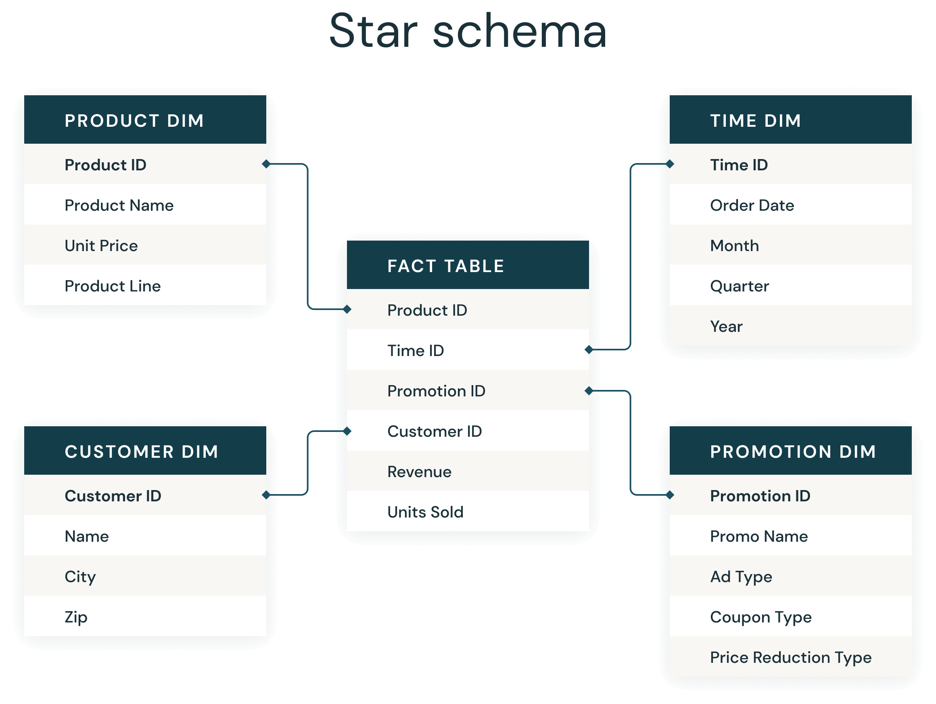
STAR SCHEMA

Slide 42
DATA VAULT
Data Vault
Developed by Dan Linstedt
  An agile methodology for building scalable enterprise data warehouses.
Core Components:
  Hubs: Store unique business keys (e.g., Customer ID, Product ID).
  Links: Establish relationships among Hubs (e.g., transactions, associations).
  Satellites: Capture descriptive attributes and historical context linked to Hubs or Links (e.g., customer address, product details).
Advantages:
  Flexible for changing business needs (schema evolution).
  Strong auditability and traceability of historical data.
  Decouples business keys from descriptive data, simplifying updates.
Usage:
  Ideal for complex, rapidly evolving data environments.
  Supports incremental loading and robust history tracking.

Slide 43
DATA VAULT
No distinction is made between good and bad data
  What is good and what is bad?
  Bad can/means, not in accordance with business rules
  all the data, all of the time
  is determined from a certain perspective or moment in time
All data is relevant

Slide 44
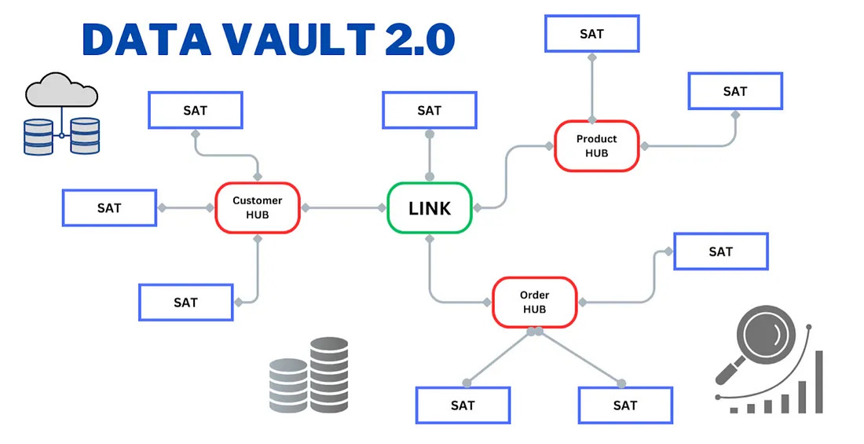
DATA VAULT

Slide 45
DATAVAULT HUBS
Unique list of business keys
    Drive of the hub
    Can consist of multiple columns
Presence of surrogate keys
  necessary to keep the model together
Metadata over de business key
  Record source
    Which source system loaded the key first
  Load date
    When was the key loaded
  Etc…
A hub can only contain 1 business key
  Except if 2 systems provide the same business key but with a different meaning
A hub has at least 1 satellite
Forms the structure of the model

Slide 46
DATAVAULT LINKS
Used to model associations or transactions between business keys
  For example : employee <-> shop
Many-to-many join tables with metadata
  A link table can link to another link table
  To handle differences in granularity
  Mostly bad practice since you can’t load in parallel
Forms the structure in a model

Slide 47
DATAVAULT SATELLITE
Hubs and links form the structure, but have no temporal and descriptive components
  A satellite does have this
descriptive data is stored in a satellite
  All information about an employee or a shop
  At least 1 attribute is necessary
Contains the connection to the hub or link
Metadata
  Record source
  Load date
  Valid_from/valid_to date

Slide 48
DATAVAULT REFERENCE TABLES
Reference datesSo that it does not have to be stored several times
  cities
  countries
  regions
  Etc …
Used by satellites not by hubs or links

Slide 49
DATAVAULT LOADING PRACTICES
Very simple
first the hubs
  All hubs can be loaded in parallel, as a hub never hangs from a hub, but always with a link between them
Second the links
At the same time the satellites can be loaded since they are connected to the hub
Finally, one can load the satellites hanging on the links

Slide 50
DATAVAULT LOADING PRACTICES
Benefits
  Easy automation of the ETL
  ETL can be generated automatically
Data is never removed
  Except if a technical issue arises during loading

Slide 51
DATAVAULT READING PRACTICES
Datavault is not optimized for query performance
Almost all BI tools expect a dimensional model
  A conversion is necessary
Hub + satellite = dimension
  Mostly a database view
Hub + satellite + link = Fact
  Mostly a database view

Slide 52
DATAVAULT 2.0
https://fr.slideshare.net/slideshow/dv-20-md5-hash-cdc/39756921

Slide 53
CDC (CHANGE DATA CAPTURE)
What is CDC?
  CDC stands for Change Data Capture
  Captures every change event (insert, update, delete) in a database
  Enables near real-time replication and integration across systems

Slide 54
CDC
Challenges
  Don’t read all the data again every time
  Detection of inserts / updates / deletes
  Extraction of big data volumes (initial loads vs increments)
  Slow or unstable network
  → CDC & Incremental to the rescue

Slide 55
CDC
Why CDC?
  Real-Time Data Replication: Keeps systems like data warehouses, analytics platforms, and microservices up-to-date.
  Reduced Overhead: Processes only recent changes instead of full table scans.
  Event-Driven Architectures: Triggers real-time events (e.g., updating recommendation engines).
  Auditing & Compliance: Provides a detailed history of data changes.

Slide 56
CDC
Key Components of CDC
  Transaction Logs: The primary source capturing all database changes.
  CDC Mechanisms: Methods to extract these changes (detailed in next slides).
  Change Data Consumers: Systems that process these changes (e.g., analytics platforms, data warehouses).

Slide 57
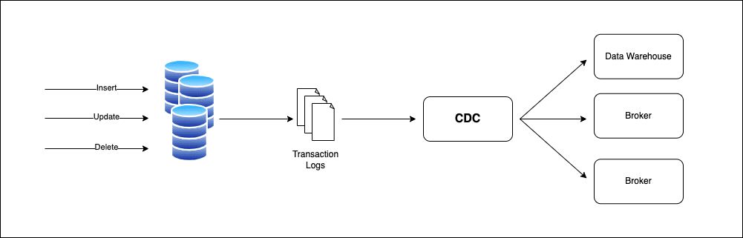
CDC

Slide 58
CDC
Diff-Based CDC:
  How it works: Compares current data with a snapshot of a previous state.
  Pros: Works with any database.
  Cons: Resource-intensive and high latency.
Timestamp-Based CDC:
  How it works: Uses a ”last_updated” timestamp column.
  Pros: Simple implementation.
  Cons: May miss deletions; relies on accurate timestamps.

Slide 59
CDC
Trigger-Based CDC:
  How it works: Database triggers log changes to an audit table.
  Pros: Captures row-level changes.
  Cons: Can impact performance due to overhead.
Log-Based CDC:
  How it works: Reads changes directly from the transaction log.
  Pros: High performance, low latency.
  Cons: Requires log access and can be complex to implement.

Slide 60
CDC
CDC Mechanism Comparisons
Diff-Based CDC:
  Pros: Universally applicable.
  Cons: Full table scans; not real-time.
Timestamp-Based CDC:
  Pros: Lightweight and easy.
  Cons: Doesn’t capture deletions well.

Slide 61
CDC
CDC Mechanism Comparisons
Trigger-Based CDC:
  Pros: Immediate, row-level change capture.
  Cons: Can slow down write operations.
Log-Based CDC:
  Pros: Minimal impact on performance; captures all change types.
  Cons: More complex; depends on specific database log formats.

Slide 62
Diff based CDC
This approach compares the current state of the table with a previous state to identify changes

Slide 63
Diff based CDC
-- Step 1: Create a snapshot table to store the previous state
CREATE TABLE customers_snapshot AS
SELECT * FROM customers;
-- Step 2: Compare the current state with the snapshot to
identify changes
SELECT *
FROM customers
EXCEPT
SELECT *
FROM customers_snapshot;

Slide 64
Diff based CDC
-- Step 3: Update the snapshot table
TRUNCATE TABLE customers_snapshot;
INSERT INTO customers_snapshot
SELECT * FROM customers;

Slide 65
Diff based CDC
Periodically, the current state of the table is compared with a snapshot of the previous state of identify changes. As stated in the previous section, this approach is resource-intensive and not suitable for real-time use cases.

Slide 66
Timestamp based CDC
This approach relies on a last_updated (or whatever field name you choose) column in the table to track changes

Slide 67
Timestamp based CDC
-- Step 1: Create the main table with a timestamp column
CREATE TABLE orders (
id SERIAL PRIMARY KEY,
product_name TEXT NOT NULL,
quantity INT NOT NULL,
last_updated TIMESTAMP DEFAULT CURRENT_TIMESTAMP
);
-- Step 2: Query for changes
SELECT *
FROM orders
WHERE last_updated > '2023-10-01 00:00:00';

Slide 68
Timestamp based CDC
Every time a row is inserted or updated, the last_updated column is automatically set to the current timestamp. To capture changes, query the table for rows where last_updated is greater than the last recorded timestamp. Note that this approach cannot detect deletions unless you use a soft delete mechanism (e.g., an is_deleted column).

Slide 69
Trigger based CDC
In PostgreSQL, you can use triggers to capture changes and store them in a separate audit table

Slide 70
Trigger based CDC
Step 1: Create the main table
CREATE TABLE customers (
id SERIAL PRIMARY KEY,
name TEXT NOT NULL,
email TEXT NOT NULL
);
-- Step 2: Create an audit table to store changes
CREATE TABLE customers_audit (
id SERIAL PRIMARY KEY,
operation CHAR(1) NOT NULL, -- 'I' for insert, 'U' for update, 'D’
for delete
old_data JSONB,
new_data JSONB,
change_time TIMESTAMP DEFAULT CURRENT_TIMESTAMP
);

Slide 71
Trigger based CDC
Step 3: Create a trigger function
CREATE OR REPLACE FUNCTION log_customer_changes()
RETURNS TRIGGER AS $$
BEGIN
IF TG_OP = 'INSERT' THEN
INSERT INTO customers_audit (operation, new_data)
VALUES ('I', row_to_json(NEW));
ELSIF TG_OP = 'UPDATE' THEN
INSERT INTO customers_audit (operation, old_data, new_data)
VALUES ('U', row_to_json(OLD), row_to_json(NEW));
ELSIF TG_OP = 'DELETE' THEN
INSERT INTO customers_audit (operation, old_data)
VALUES ('D', row_to_json(OLD));
END IF;
RETURN NEW;
END;
$$ LANGUAGE plpgsql;

Slide 72
Trigger based CDC
-- Step 4: Attach the trigger to the customers table
CREATE TRIGGER customers_change_trigger
AFTER INSERT OR UPDATE OR DELETE ON customers
FOR EACH ROW EXECUTE FUNCTION log_customer_changes();

Slide 73
Trigger based CDC
The trigger logs changes in the customers_audit table whenever a row is inserted, updated, or deleted in the customers table. The operation column indicates the type of change (I, U, or D), and the old_data and new_data columns store the row data before and after the change.

Slide 74
Log based CDC
PostgreSQL provides a feature called Logical Decoding (via the pg_logical extension) to capture changes from the transaction log (Write-Ahead Log or WAL). To use this feature you need to enable Logical Decoding.

Slide 75
Log based CDC
-- Step 1: Modify the PostgreSQL configuration (postgresql.conf)
wal_level = logical
max_replication_slots = 5
-- Restart the PostgreSQL server to apply changes

Slide 76
Log based CDC
Once you have done that you need to create a replication slot:
-- Step 2: Create a replication slot
SELECT * FROM pg_create_logical_replication_slot('cdc_slot’,
'test_decoding’);
Then you consume the changes from the replication slot. You can use a custom script or Debezium. Example us pg_recvlogical:
pg_recvlogical -d my_db --slot=cdc_slot --start -f -

Slide 77
Log based CDC
Or if you want to write a custom script in Python, you can do the following:
import psycopg2
conn = psycopg2.connect("dbname=mydb user=myuser
password=mypassword“)
cur = conn.cursor()
cur.execute("SELECT * FROM
pg_logical_slot_get_changes('cdc_slot', NULL, NULL);")
changes = cur.fetchall()
for change in changes:
print(change)

Slide 78
Log based CDC
The SELECT * FROM pg_logical_slot_get_changes('cdc_slot', NULL, NULL); fetches changes since the last read.
In this approach, PostgreSQL writes all changes to the WAL. Logical decoding extracts these changes and makes them available for consumption. Tools like Debezium or custom scripts can process these changes and send them to downstream systems.

Slide 79
CDC
Popular CDC Tools and Technologies
Debezium: An open-source distributed platform for CDC, Debezium connects to databases like MySQL, PostgreSQL, and SQL Server, and streams change events to Apache Kafka. It's widely used for building event-driven architectures.
AWS Database Migration Service (DMS): AWS DMS supports CDC for replicating data between on-premises databases and AWS cloud services. It's a fully managed service that handles the complexities of CDC for you.
Google Cloud Dataflow: Google's stream and batch data processing service can be used to implement CDC pipelines. It integrates with various databases and supports real-time data processing.

Slide 80
CDC
Summary
What is CDC? A near real-time mechanism to track and replicate database changes.
Why Use It? Minimizes load on source systems, supports event-driven architectures, and keeps data synchronized across transactional databases, data warehouses, and search engines.

Slide 81
CDC
Summary
CDC Methods: Diff-Based, Timestamp-Based, Trigger-Based, and Log-Based (e.g., WAL in PostgreSQL).
Challenges: Performance overhead, data consistency, and managing schema changes.
Popular Tools: Debezium, AWS DMS, Google Cloud Dataflow, Fivetran...
Best Practices: Choose the right CDC method for your use case, monitor performance, and carefully handle schema updates.

Slide 82
CDC
References
Reis, J., & Housley, M. (2022). Fundamentals of Data Engineering: Plan and Build Robust Data Systems (1st edition). O'Reilly Media.
Kleppmann, M. (2017). Designing Data-Intensive Applications: The Big Ideas Behind Reliable, Scalable, and Maintainable Systems.

Slide 83
QUERY PLAN
  An ordered set of operations that are being executed to fetch the correct dataset from the database(*RDBMS)
    SQL relational database management system
  Explain plan = results of a query plan / query access paths
    https://en.wikipedia.org/wiki/Query_plan#Generating_query_plans

Slide 84
Performance tuning

Slide 85
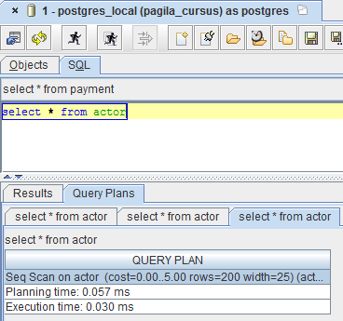
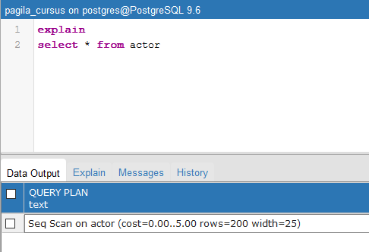
QUERY PLAN
  Mostly used to check what the database needs to do to fetch the data
  Most important to write performant queries on big datasets and joins

Slide 86
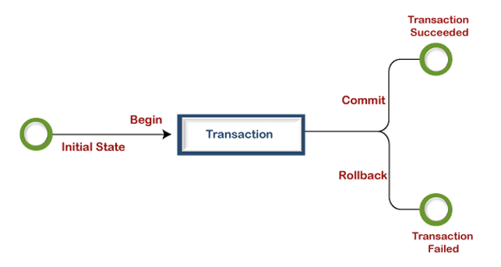
TRANSACTION
  A transaction is a sequence of SQL statements that are executed as a single logical unit of work. It ensures data consistency and integrity by either committing all changes or rolling them back if an error occurs.

Slide 87
INDEXING
  Get data more efficiently out of the database
  An index is always related to a table
  An index can contain one or more columns
  A table can have more then 1 index
  An index has a link to the corresponding database records
  Indexing on a small datasets will not make a big difference, but once the table grows index on the correct columns will speed up your query drastically

Slide 88
WHY INDEXING
  Get data more efficiently out of the database!
  Random lookup against a table without traversing the entire table
  Index wise joins
    A join that only uses two indexes from 2 tables to join the data, without joining the entire tables

Slide 89
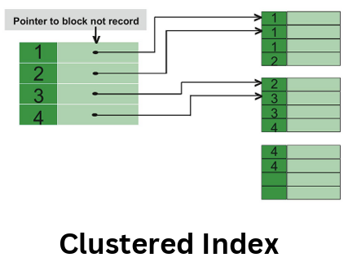
CLUSTERED INDEX
  A clustered index determines the physical order of data in a table. It changes the way the data is stored on disk and can be created on only one column.
  A table can have only one clustered index.

Slide 90
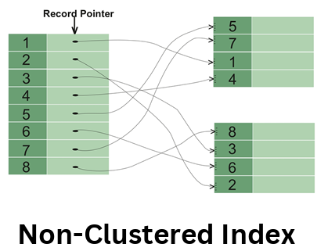
NON-CLUSTERED INDEX
  A non-clustered index does not affect the physical order of data in a table. It is stored separately and contains a pointer to the actual data.
  A table can have multiple non-clustered indexes.

Slide 91
TYPES OF INDEXES
  B-tree Unique index PK
  B-tree non unique index
  Bitmap index
  Reverse index
  …

Slide 92
B-TREE INDEX
  Balanced tree index
  Unique / non unique
  Can be used with each cardinality
  Efficiency increases when cardinality goes up
  Efficient structure to handles inserts/updates/deletes
  Different implementations on different databases
    Mysql / PostgreSQL / Oracle / DB2 / Terradata

Slide 93
B-TREE INDEX
https://www.cs.usfca.edu/~galles/visualization/BTree.html

Slide 94
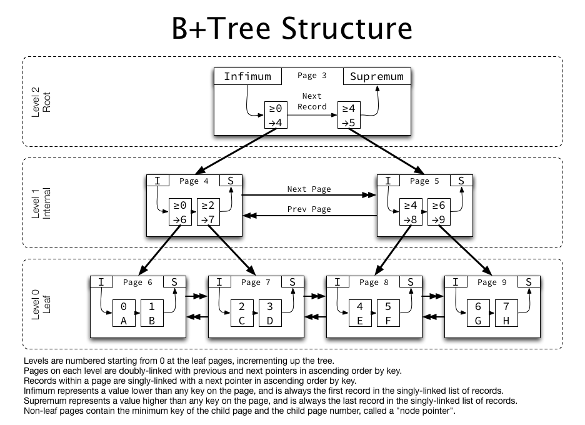
B-TREE INDEX

Slide 95
BITMAP INDEX
  Used on low cardinality
  Absolute or relative against the total amount of values
  Less robust than a b-tree indexes for inserts/deletes
  Used a lot in read-only tables

Slide 96
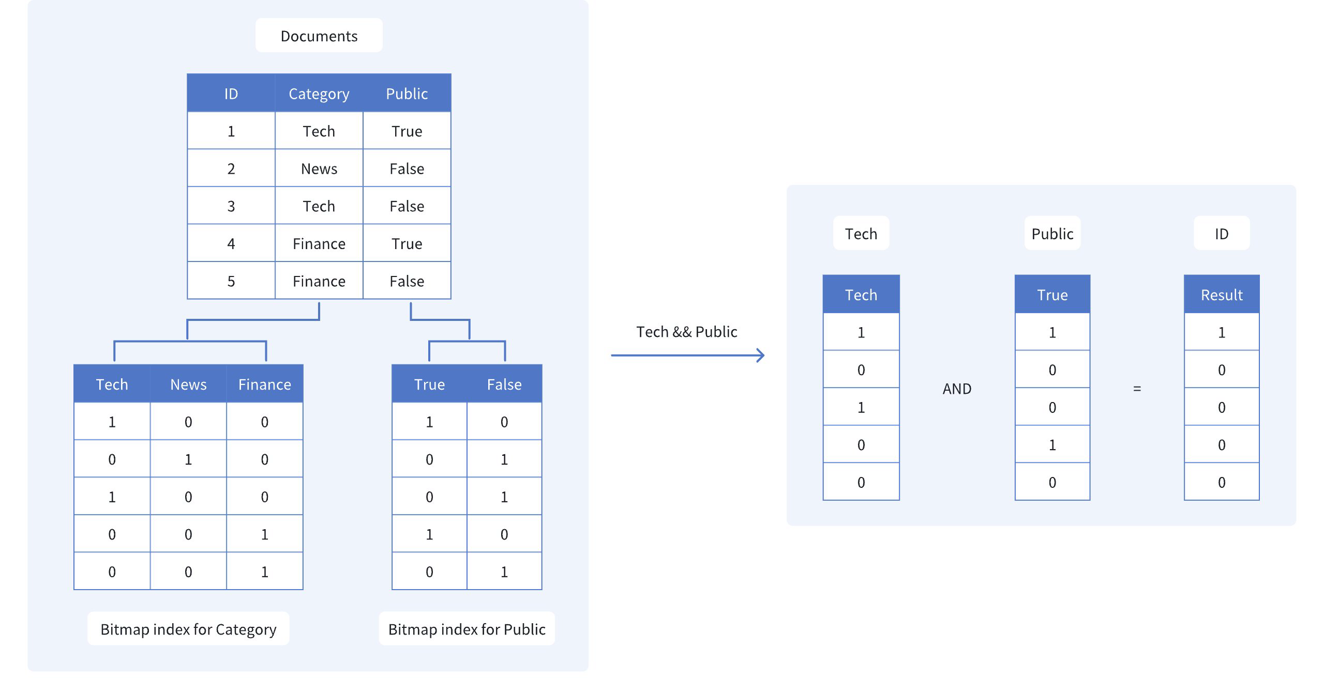
BITMAP INDEX

Slide 97
REVERSE B-TREE INDEXES
  Reverses the values then adds them to the index
  Uses the b-tree index system
    1234 becomes 4321
    “thomasmore” becomes “eromsamoht”
  Mostly used for indexes where parallel inserts are being done
    Oltp systems (online transaction processing systems)
      Webshops
      Banks
      …
    Datawarehouse tables

Slide 98
PARTITIONING
  Big database tables are being divided in smaller chunks
    Called partitions / sub partitions
  Makes it possible that not the entire table needs to be traversed but only a part
    Partition pruning !
  This increases performance because less data needs to be read from disk
  Indexes on a partitioned table can be partitioned
    But not necessarily
    A non partitioned table can have a partitioned index

Slide 99
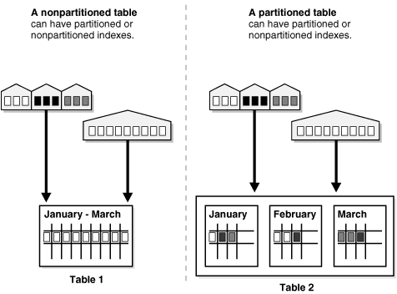
PARTITIONING WITH INDEXES

Slide 100
WAYS OF PARTITIONING
  List partitioning
    Division through distinct values
  Range partitioning
    Division by time / incremental id’s / …
  Hash partitioning
    Independent of the values itself
    Partition key goes through a hashing algorithm and ends up in the correct partition

Slide 101
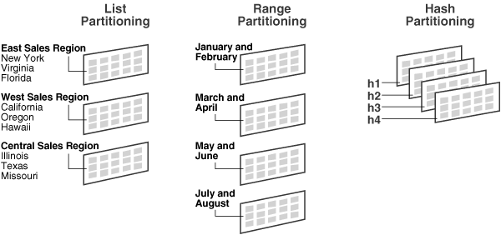
PARTITIONING

Slide 102
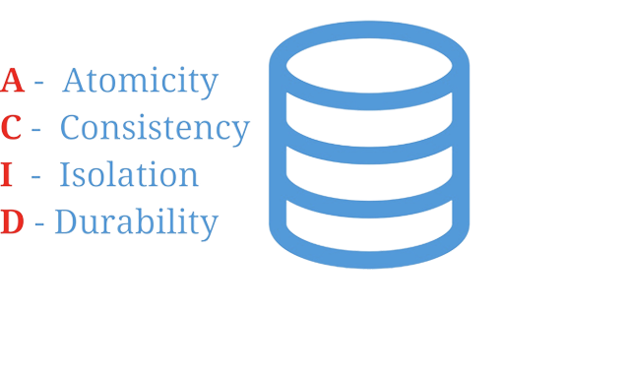
ACID TRANSACTION
  ACID stands for Atomicity, Consistency, Isolation, and Durability. It is a set of properties that guarantee reliable processing of database transactions.

Slide 103
ACID TRANSACTION
  Atomicity ensures that a transaction is treated as a single unit of work, either all or none of the changes are applied.
  Consistency ensures that a transaction brings the database from one valid state to another.
  Isolation ensures that concurrent transactions do not interfere with each other.
  Durability ensures that once a transaction is committed, its changes are permanent and survive system failures.

Slide 104
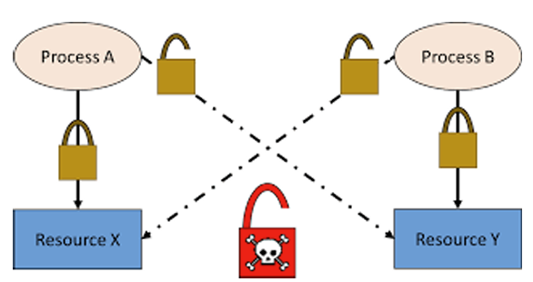
DEADLOCK
  A deadlock occurs when two or more transactions are waiting for each other to release resources, resulting in a circular dependency. As a result, none of the transactions can proceed, and the system may become unresponsive.

Slide 105
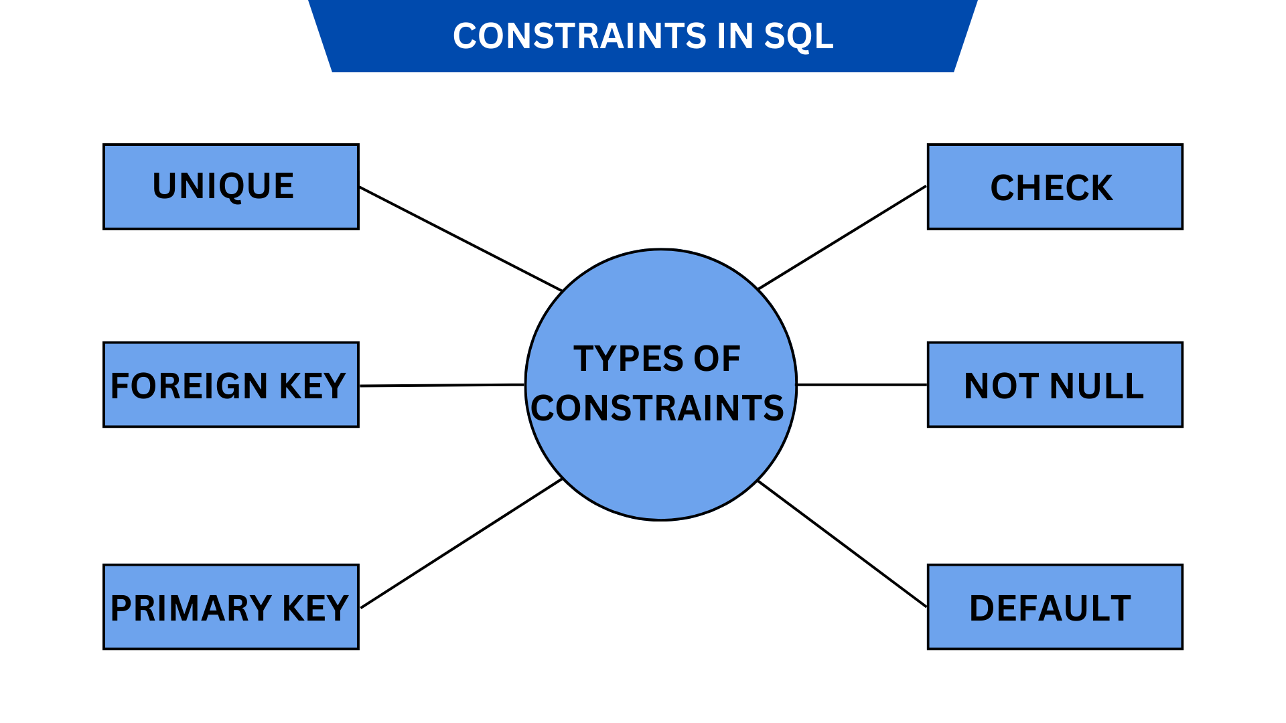
TABLES CONSTRAINTS

Slide 106
TABLES CONSTRAINTS
-- Create a 'departments' table with a PRIMARY KEY and a UNIQUE constraint
CREATE TABLE departments (
department_id INT NOT NULL,
department_name VARCHAR(100) NOT NULL,
location VARCHAR(100),
CONSTRAINT pk_departments PRIMARY KEY (department_id),
CONSTRAINT uq_department_name UNIQUE (department_name)
);

Slide 107
TABLES CONSTRAINTS
-- Create an 'employees' table with multiple constraints:
-- 1. PRIMARY KEY
-- 2. NOT NULL for required fields
-- 3. CHECK to validate salary is > 0
-- 4. FOREIGN KEY referencing 'departments'
CREATE TABLE employees (
employee_id INT NOT NULL,
first_name VARCHAR(50) NOT NULL,
last_name VARCHAR(50) NOT NULL,
hire_date DATE NOT NULL,
salary DECIMAL(10,2),
department_id INT,
CONSTRAINT pk_employees PRIMARY KEY (employee_id),
CONSTRAINT ck_salary CHECK (salary > 0),
CONSTRAINT fk_department
FOREIGN KEY (department_id)
REFERENCES departments(department_id)
ON DELETE SET NULL -- or CASCADE/RESTRICT, as preferred
);

Slide 108
TABLES CONSTRAINTS
  In this example:
  departments has a primary key on department_id and a unique constraint on department_name.
employees has:
  Primary key on employee_id.
  Required (NOT NULL) fields (first_name, last_name, hire_date).
  A CHECK constraint ck_salary ensuring salary is always greater than zero.
  A foreign key fk_department referencing the departments table, with ON DELETE SET NULL

Slide 109
View VS Materialized View
  A view is a virtual table that fetches data dynamically whenever queried, which can lead to slower performance for complex queries.
  A materialized view, however, stores query results physically, making retrieval faster but requiring periodic refresh to reflect changes in the underlying data.

